Slide 1
WEEK 13
MUHAMMAD NAEEM AKHTAR

Slide 2
Generic Programming
The advantages of Generic Programming are
Code Reusability
Avoid Function Overloading
Once written it can be used for multiple times and cases.
It is implemented using templates in C++

Slide 3
Templates in C++
A template is a simple yet very powerful tool in C++.
The simple idea is to pass data type as a parameter so that we don’t need to write the same code for different data types.
For example, a software company may need to sort() for different data types.
Rather than writing and maintaining multiple codes, we can write one sort() and pass data type as a parameter.
C++ adds two new keywords to support templates: ‘template’ and ‘typename’.
The second keyword can always be replaced by the keyword ‘class’.

Slide 4
Templates in C++
A template is a simple yet very powerful tool in C++.
The simple idea is to pass data type as a parameter so that we don’t need to write the same code for different data types.
For example, a software company may need to sort() for different data types.
Rather than writing and maintaining multiple codes, we can write one sort() and pass data type as a parameter.
C++ adds two new keywords to support templates: ‘template’ and ‘typename’.
The second keyword can always be replaced by the keyword ‘class’.

Slide 5
How Templates Works?
Templates are expanded at compiler time.
This is like macros. The difference is, that the compiler does type checking before template expansion.
The idea is simple, source code contains only function/class, but compiled code may contain multiple copies of the same function/class.

Slide 6
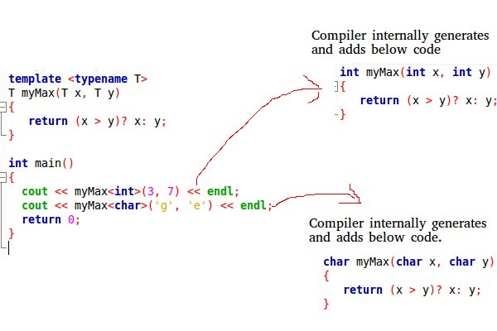

Slide 7
Function Templates
We write a generic function that can be used for different data types. Examples of function templates are sort(), max(), min(), printArray().
See example: template1.cpp, template2.cpp

Slide 8
Class Templates
like function templates, class templates are useful when a class defines something that is independent of the data type. Can be useful for classes like LinkedList, BinaryTree, Stack, Queue, Array, etc.
See template3.cpp template4.cpp

Slide 9
The C++ Standard Template Library (STL)
The Standard Template Library (STL) is a set of C++ template classes to provide common programming data structures and functions such as lists, stacks, arrays, etc.
It is a library of container classes, algorithms, and iterators.
It is a generalized library and so, its components are parameterized.
Working knowledge of template classes is a prerequisite for working with STL.

Slide 10
The C++ Standard Template Library (STL)
STL has 4 components:
Algorithms
Containers
Functions
Iterators

Slide 11
1. Algorithms
The header algorithm defines a collection of functions specially designed to be used on a range of elements. They act on containers and provide means for various operations for the contents of the containers.
Sorting
Searching
Important STL Algorithms

Slide 12
Sorting
Sorting is one of the most basic functions applied to data.
It means arranging the data in a particular fashion, which can be increasing or decreasing.
There is a builtin function in C++ STL by the name of sort().
This function internally uses IntroSort.
In more details it is implemented using hybrid of QuickSort, HeapSort and InsertionSort.
By default, it uses QuickSort but if QuickSort is doing unfair partitioning and taking more than N*logN time, it switches to HeapSort and
when the array size becomes really small, it switches to InsertionSort.

Slide 13
Sorting
The prototype for sort is :
sort(startaddress, endaddress)
startaddress: the address of the first element of the array
endaddress: the address of the next contiguous location of
the last element of the array.
So actually sort() sorts in the range of [startaddress,endaddress)
See example code: sorting1.cpp

Slide 14
Binary Search
Binary search is a widely used searching algorithm that requires the array to be sorted before search is applied.
The main idea behind this algorithm is to keep dividing the array in half (divide and conquer) until the element is found, or all the elements are exhausted.
It works by comparing the middle item of the array with our target, if it matches, it returns true otherwise if the middle term is greater than the target, the search is performed in the left sub-array.
If the middle term is less than the target, the search is performed in the right sub-array.

Slide 15
Binary Search
The prototype for binary search is :
binary_search(startaddress, endaddress, valuetofind)
Parameters :
startaddress: the address of the first
element of the array.
endaddress: the address of the next contiguous
location of the last element of the array.
valuetofind: the target value which we have
to search for.
Returns :
true if an element equal to valuetofind is found, else false.
See Example Code: BinarySearch1.cpp

Slide 16
Important STL Algorithm
Non-Manipulating Algorithms
sort(first_iterator, last_iterator) – To sort the given vector.
sort(first_iterator, last_iterator, greater<int>()) – To sort the given container/vector in descending order
reverse(first_iterator, last_iterator) – To reverse a vector. ( if ascending -> descending OR if descending -> ascending)
*max_element (first_iterator, last_iterator) – To find the maximum element of a vector.
*min_element (first_iterator, last_iterator) – To find the minimum element of a vector.
accumulate(first_iterator, last_iterator, initial value of sum) – Does the summation of vector elements
Notes:
https://www.geeksforgeeks.org/c-magicians-stl-algorithms/

Slide 17
Containers
Containers or container classes store objects and data.
There are in total seven standards “first-class” container classes and three container adaptor classes and only seven header files that provide access to these containers or container adaptors.
Details are given in foot print of this slide
We will see example of stack and queue.
Notes:
Sequence Containers: implement data structures that can be accessed in a sequential manner.
vector
list
deque
arrays
forward_list( Introduced in C++11)
Container Adaptors: provide a different interface for sequential containers.
queue
priority_queue
stack
Associative Containers: implement sorted data structures that can be quickly searched (O(log n) complexity).
set
multiset
map
multimap
Unordered Associative Containers: implement unordered data structures that can be quickly searched
unordered_set (Introduced in C++11)
unordered_multiset (Introduced in C++11)
unordered_map (Introduced in C++11)
unordered_multimap (Introduced in C++11)

Slide 18
Stack in STL
Stacks are a type of container adaptors with LIFO(Last In First Out) type of working, where a new element is added at one end (top) and an element is removed from that end only.
If there is confusion in remembering the basic difference between stack and queue, then just have a real life example for this differentiation, for stack, stacking of books we can take the top book easily and for queue remember when you have to stand in queue front of ATM for taking out the cash, then first person near to ATM has the first chance to take out the money from ATM. So, queue is the FIFO (First In First Out) type working.
Notes:
Stack uses an encapsulated object of either vector or deque (by default) or list (sequential container class) as its underlying container, providing a specific set of member functions to access its elements.

Slide 19
Stack in STL
The functions associated with stack are: empty() – Returns whether the stack is empty – Time Complexity : O(1) size() – Returns the size of the stack – Time Complexity : O(1) top() – Returns a reference to the top most element of the stack – Time Complexity : O(1) push(g) – Adds the element ‘g’ at the top of the stack – Time Complexity : O(1) pop() – Deletes the most recent entered element of the stack – Time Complexity : O(1)
See example code: Stack1.cpp
Notes:
Code Explanation:
Include the iostream header file or <iostream> in our code to use its functions.
Include the stack header file in our code to use its functions if already included <iostream> then no need of stack header file because it has already inbuilt function in it.
Include the std namespace in our code to use its classes without calling it.
Call the main() function. The program logic should be added within this function.
Create a stack to store integer values.
Use the push() function to insert the value 21 into the stack.
Use the push() function to insert the value 22 into the stack.
Use the push() function to insert the value 24 into the stack.
Use the push() function to insert the value 25 into the stack.
Use a integer variable “num” to enter a variable value. Here its value is 0, but we can assign any integer value using cin >> num.
Use the push() function to insert the value of “num” variable.
Use the pop() function to remove the top element from the stack, that is, 25. The top element now becomes 24.
Use the pop() function to remove the top element from the stack, that is, 24. The top element now becomes 22.
Use a while loop and empty() function to check whether the stack is NOT empty. The ! is the NOT operator. So, when stack is not empty then empty() function will return false and NOT operator convert it in true and the while loop keep running. But, when the stack become empty then empty() function will return true and NOT operator will make it false and the loop come to an end.
Printing the current contents of the stack on the console.
Call the pop() function on the stack.
End of the body of the while loop.
End of the main() function body.

Slide 20
Queue in C++ Standard Template Library (STL)
Queues are a type of container adaptors that operate in a first in first out (FIFO) type of arrangement. Elements are inserted at the back (end) and are deleted from the front.
See example code Queue1.cpp
Notes:
Queues use an encapsulated object of deque or list (sequential container class) as its underlying container, providing a specific set of member functions to access its elements.

Slide 21
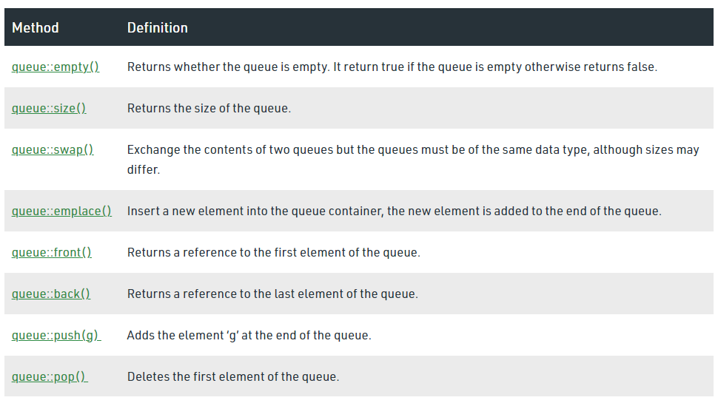
Queue in C++ Standard Template Library (STL)

Slide 22
3. Functions
The STL includes classes that overload the function call operator. Instances of such classes are called function objects or functors. Functors allow the working of the associated function to be customized with the help of parameters to be passed.
See example code Functors1.cpp

Slide 23
4. Iterators
As the name suggests, iterators are used for working on a sequence of values. They are the major feature that allows generality in STL
Operations of iterators :-
1. begin() :- This function is used to return the beginning position of the container.
2. end() :- This function is used to return the after end position of the container.
3. advance() : Next position
4. next() :- This function returns the new iterator that the iterator would point after advancing the positions mentioned in its arguments.
5. prev() :- This function returns the new iterator that the iterator would point after decrementing the positions mentioned in its arguments.
See example code: Iterator1.cpp

